Slide 1
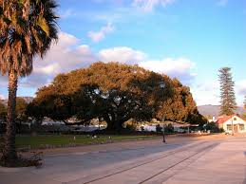
Moreton Bay Fig Trees are also known as Australian Banyan Trees. Their scientific name is Ficus macropylla.
They are native to the east coast of Queensland.
Moreton Bay Fig Trees grow into very large trees. They are too big for people’s gardens but they are wonderful shade trees in parks. Their canopy can grow as large as a football field.

Slide 2
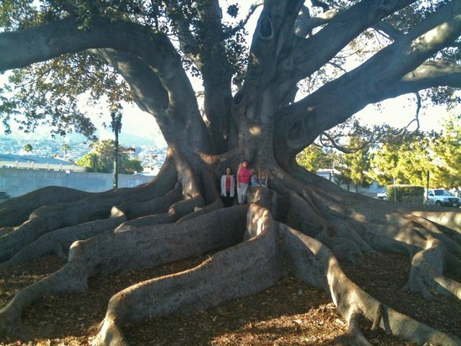
Moreton Bay Fig Trees have huge roots that grow along the ground. They are called buttress roots and they stabilize the tree so that it doesn’t fall over.

Slide 3
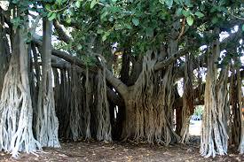
There are two very different ways that a Moreton Bay Fig Tree can grow. If it grows from a seedling that has been planted in the ground, it grows like many other trees. The seed sprouts and gradually the tree grows taller and the trunk thickens. The other way is very interesting. A bird eats the fruit that grows on the tree and later leaves its droppings in the branches of a different tree. This time special roots called aerial roots quickly grow down to the ground and become thicker. They eventually strangle the host tree until it dies and the Fig Tree takes its place.

Slide 4
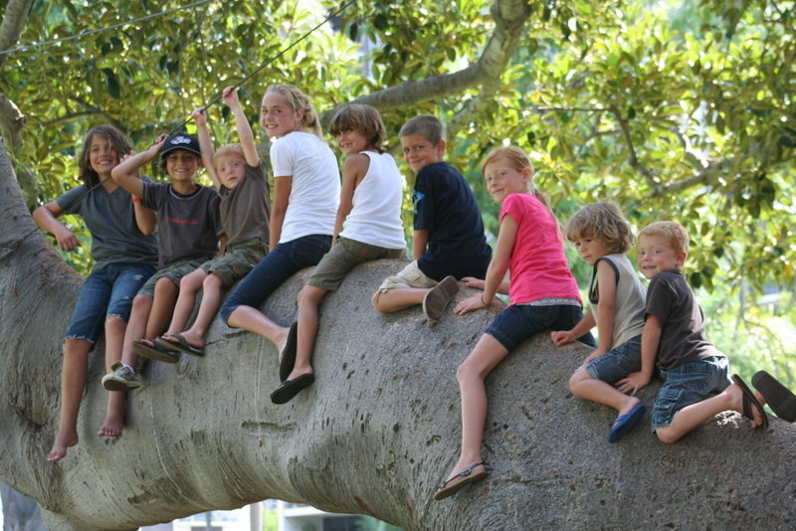
A Moreton Bay Fig Tree can live for hundreds of years. They can be wonderful trees to play in and under.

Slide 5
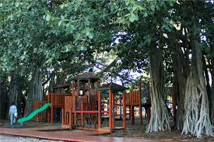
Maybe you have visited this Brisbane playground in New Farm Park beside the river? It has a great playground that has been built amongst some large Fig Trees.

Slide 6
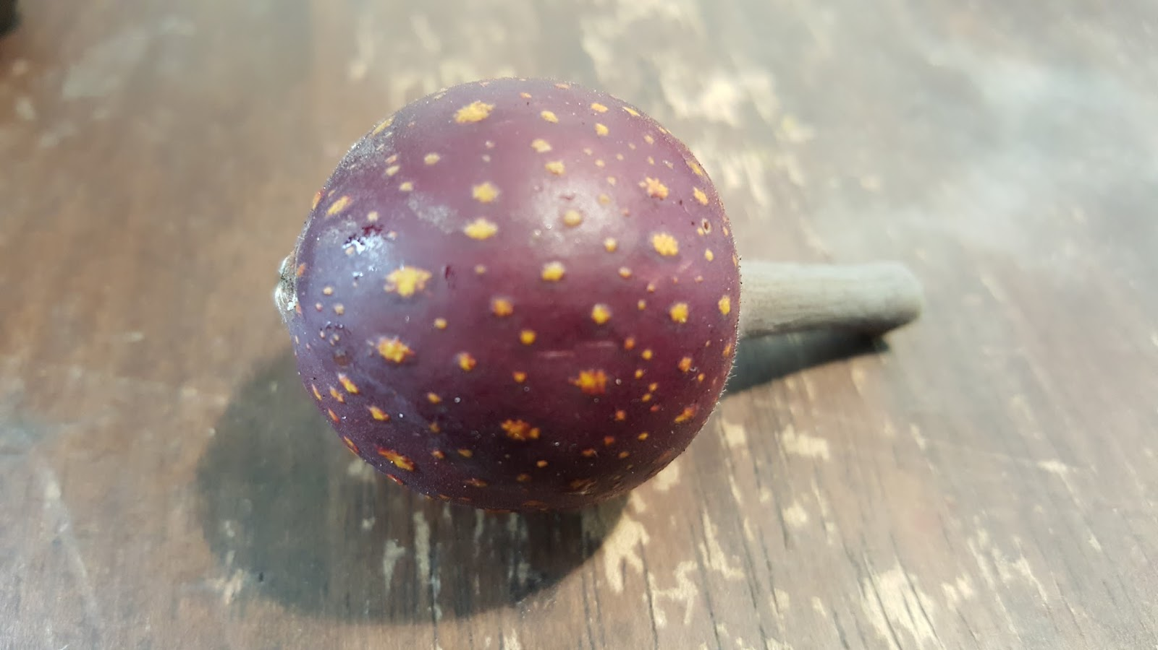
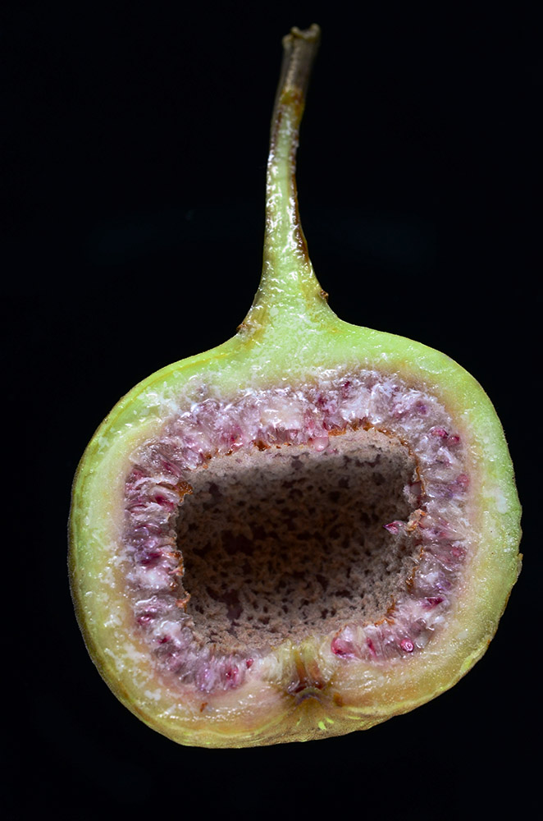
This is what the fruit of the Moreton Bay Fig Tree looks like.

